Slide 1

Ontology-Based Enterprise Description of Nordic Learning Solutions
Seminar 4 – Knowledge Management & Ontologies (OWL)
Presented by Group 4 – Adrian Nasrat, Diana Dawidi, Tesnim Omran, Ibrahim Mizher

Slide 2
Purpose of the Ontology
Support knowledge management in the enterprise
Provide a shared understanding of key concepts
Extend the ER model with semantic meaning
Enable reasoning and consistency checking

Slide 3
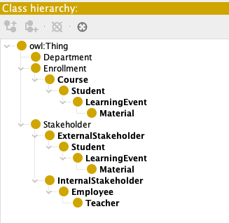
Class Hierarchy (Classes & Subclasses)
Stakeholder
InternalStakeholder (Teacher, Administrator)
ExternalStakeholder (Student)
Course
Enrollment
Material
LearningEvent

Slide 4
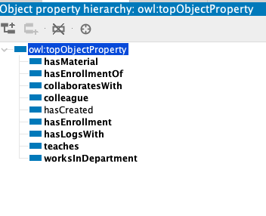
Object Properties (Relationships)
Teacher teaches Course
Course hasMaterial Material
Student hasEnrollment Enrollment
Enrollment hasEnrollmentOf Course
LearningEvent hasLogsWith Material

Slide 5
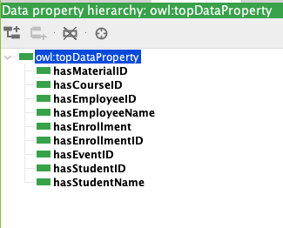
Data Properties (Attributes)
Student: hasStudentID, hasStudentName
Teacher: hasEmployeeID, hasEmployeeName
Course: hasCourseID
Enrollment: hasEnrollmentID, hasEnrollment
Material: hasMaterialID
LearningEvent: hasEventID

Slide 6
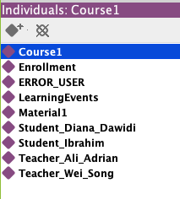
Individuals (Instances)
Student_Ibrahim, Student_Diana
Teacher_Ali_Adrian, Teacher_Wei_Song
Course1
Enrollment
Material1
LearningEvents

Slide 7
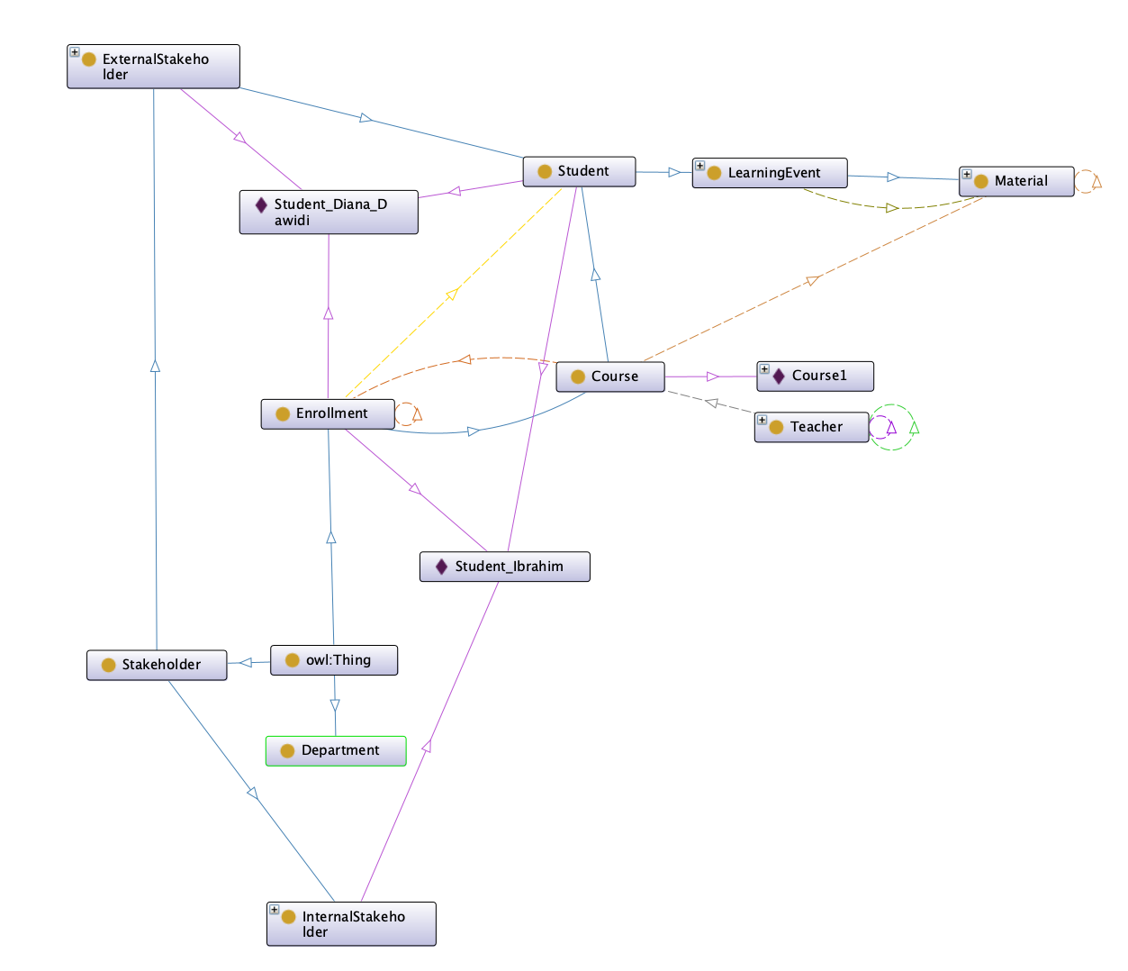
Reasoner & Logical Inconsistency
Reasoner used to validate ontology
Disjoint classes: InternalStakeholder vs ExternalStakeholder
Example inconsistency detected
Error resolved by correcting class assignment

Slide 8
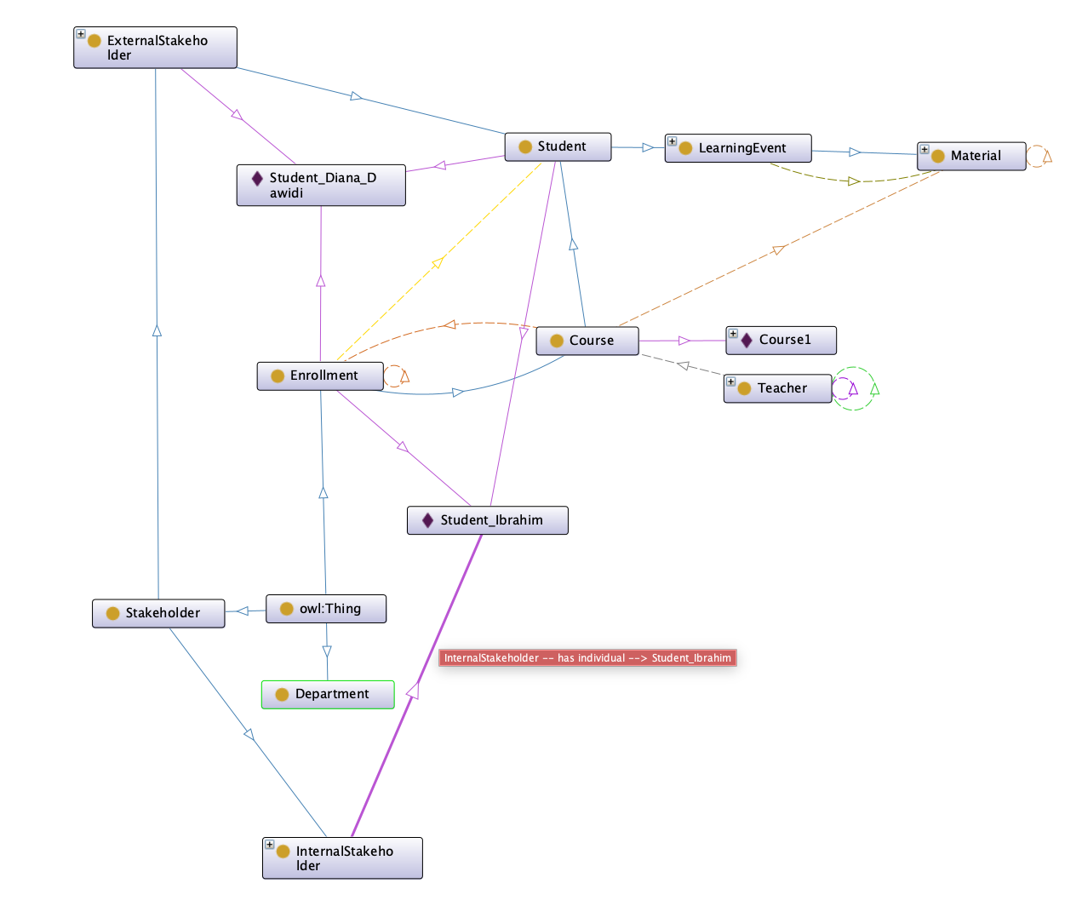
Ontology Graph View (OWL – Protégé)
Visual overview of classes, object properties, and individuals
Shows alignment with the ER model
Highlights key relationships:
Teacher → teaches → Course
Course → hasMaterial → Material
Student → hasEnrollment → Enrollment → Course
LearningEvent → logsInteractionWith → Material
Used to validate structure and semantics

Slide 9
Summary
OWL extends ER with semantic meaning
Ontology supports knowledge management
Reasoner improves data quality

Slide 10
Thank you for listening!
Questions?

